Slide 1
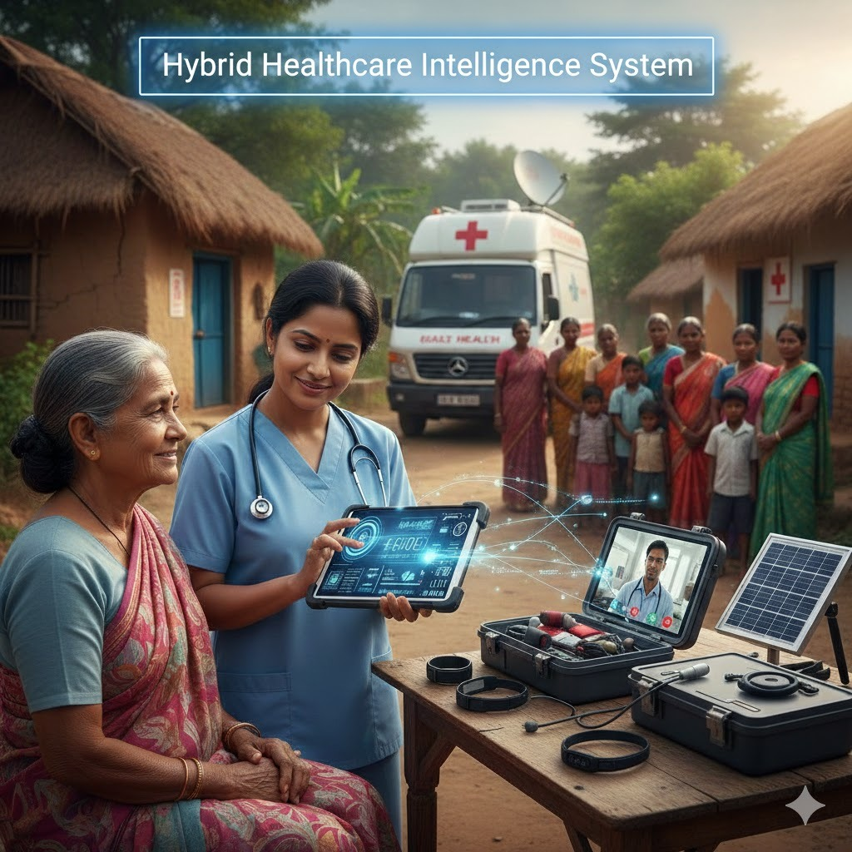

HealthAssist AI
Hybrid Healthcare Intelligence System
93.64%
Overall Accuracy
Semantic Similarity
FINAL REVIEW | TEAM CM01 | APRIL 2026
7.11%
12+
Gaddam Venu
Y22ACM430
Hallucination Rate
Languages Supported
Devandla Jeevan
Y22ACM420
Gulivindala Sri Lakshmi Sarojini
L23ACM496
Guided by
P.V. Naga Srinivas, M.Tech
Asst. Professor, Dept. of CSE (AI & ML)
Doppalapudi Sri Saiteja
Y22ACM428
Mudraboina Durga Rao
L23ACM498
Bapatla Engineering College • Dept. of CSE (AI & ML)

Slide 2
PRESENTATION OVERVIEW
01
Abstract
05
Implementation
System overview & key contributions
Tech stack, pipeline & security
02
Existing System
06
Results
Limitations of current healthcare AI tools
Performance metrics & analysis
03
Proposed System
07
Conclusion
7 clinical modules & framework
Summary & future scope
04
Design
System & Mistral architecture
HealthAssist AI | Bapatla Engineering College | 2025-26

Slide 3
ABSTRACT
HealthAssist AI bridges healthcare access gap with AI powered medical assistance. The system has seven clinical modules that would help in delivering comprehensive care. Medicine Based Guidance provides drug information, Disease based Guidance informs on the treatment protocols of various diseases. Medical Report Analysis would interpret various lab tests and would point out the abnormal lab values that are clinically significant. Image Based Medical Data Analysis would extract prescription details, dose instructions and medical information. Systems Based Analysis intends to perform the differential diagnosis with combinations of presenting compliments along with the assessment of severity. The Emergency Triage will particularly apply the red, orange, yellow and green protocols to the critically ill patient. Hospital Details will locate the facility within a radius of 30 km with the help of Geoapify API. Combining Hybrid Mistral Large AI which supports all languages and Supabase Database that can SHA-256 authenticate secure health record, it has compressive accuracy of 89.55%, Semantic similarity is 93.64%, METEOR score is 81.54%, Rouge L score is 86.12% while hallucination rate is 7.11%, it is clinically reliable for the underprivileged.
Keywords
HealthAssist AI, Supabase, Hybrid Mistral AI, Emergency Triage, Semantic Similarity, Geoapify
HealthAssist AI | Bapatla Engineering College | 2025-26

Slide 4
ABSTRACT
Overview of HealthAssist AI
"HealthAssist AI bridges the healthcare access gap with AI-powered medical assistance. The system features seven clinical modules delivering comprehensive care — from Medicine & Disease Guidance to Emergency Triage and Hospital Location — targeting underserved populations with multilingual support."
89.55%
93.64%
86.12%
0.08%
Overall Accuracy
Semantic Similarity
ROUGE-L Score
Hallucination Rate
High-quality responses across all 7 clinical modules
Strong alignment with expert medical knowledge
Structural coherence in all generated responses
Exceptionally low — prioritizing patient safety
KEYWORDS: HealthAssist AI • Supabase • Hybrid Mistral AI • Emergency Triage • Semantic Similarity • Geoapify
HealthAssist AI | Bapatla Engineering College | 2025-26

Slide 5
EXISTING SYSTEM
Limitations of Current Healthcare AI Solutions
CURRENT SYSTEMS FALL SHORT
✗ No Emergency Prioritization
✗ Text-Only, No Image Analysis
Most systems treat all health queries equally — no red/yellow/green triage. Critical emergencies go unrecognized, delaying life-saving responses.
Current systems cannot interpret medical images, prescriptions, or scanned lab reports — users with physical documents are left without digital assistance.
✗ General AI, Not Medically Trained
✗ No Multilingual Support
Generic LLMs provide vague or unreliable clinical advice. No domain-specific training leads to hallucinations and untrustworthy outputs.
Most platforms operate only in English, excluding non-English speakers and rural populations who need healthcare most.
HealthAssist AI | Bapatla Engineering College | 2025-26

Slide 6
PROPOSED SYSTEM
HealthAssist AI
Medicine Guidance
Symptom Analysis
Drug info, dosage, side effects
Differential diagnosis & medication
Disease Guidance
Emergency Triage
Treatment protocols & prevention
Red / Yellow / Green classification
Medical Report Analysis
Hospital Locator
PDF lab report extraction & insights
Nearby hospitals within 30 km via Geoapify
Image Data Analysis
EasyOCR on prescriptions & scan images
HealthAssist AI | Bapatla Engineering College | 2025-26

Slide 7
SEVEN CLINICAL MODULES
01
Medicine Guidance
05
Symptom Analysis
Ranked differential diagnosis with medication suggestions, tests & prevention stored securely in Supabase.
Dosage, frequency, safety precautions & side effects in any language via Mistral AI & Supabase.
02
Disease Guidance
06
Emergency Triage
Personalized treatment, preventive measures & lifestyle recommendations using historical Supabase data.
Red (Critical) / Yellow (Urgent) / Green (Stable) / Black (Deceased) with step-by-step emergency procedures.
03
Medical Report Analysis
07
Hospital Locator
PDF extraction via PyPDF2 → Mistral AI interprets findings, flags abnormal values & generates summaries.
Finds & ranks hospitals within 30 km via Geoapify API; verified by Mistral AI & stored in Supabase.
04
Image Medical Data
EasyOCR extracts text from scanned images/prescriptions → Mistral AI identifies clinical issues.
HealthAssist AI | Bapatla Engineering College | 2025-26

Slide 8
SYSTEM DESIGN
Multi-Layer Architecture – System Flow
APPLICATION LAYER
User Interface (Login · Signup · Chat)
AUTH LAYER
Supabase Auth · SHA-256 Password Encryption · Session Management
SERVER LAYER
Application Server · Request Handling · Chat Flow Controller & Routing
AI MODEL LAYER
Mistral Large 3 · Structured Prompts · 7 Clinical Modules · OCR Engine
DATABASE LAYER
Supabase PostgreSQL · Conversation History · Load & Restore
Each layer communicates unidirectionally. All data encrypted & routed through secure Supabase storage.
HealthAssist AI | Bapatla Engineering College | 2025-26

Slide 9
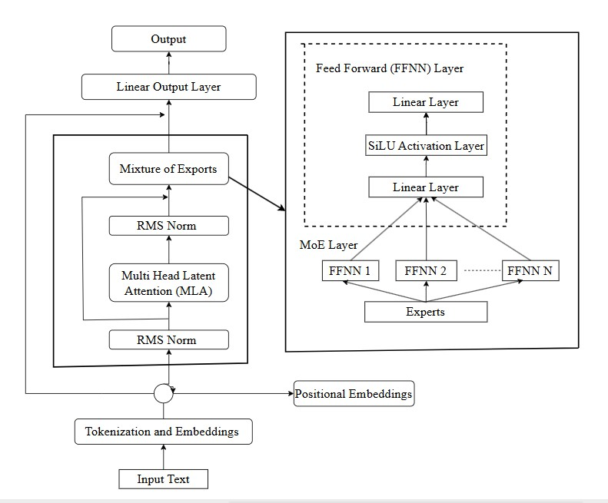
DESIGN – MISTRAL LARGE 3 ARCHITECTURE
MODEL SPECS
Total Parameters:
675 Billion
Active Parameters:
41 Billion
Vision Encoder:
2.5B Params
Context Window:
256K Tokens
Attention Heads:
128 Heads
Architecture:
MoE + MLA
Precision:
FP8 / BF16
Output:
Next-token logits
HealthAssist AI | Bapatla Engineering College | 2025-26

Slide 10
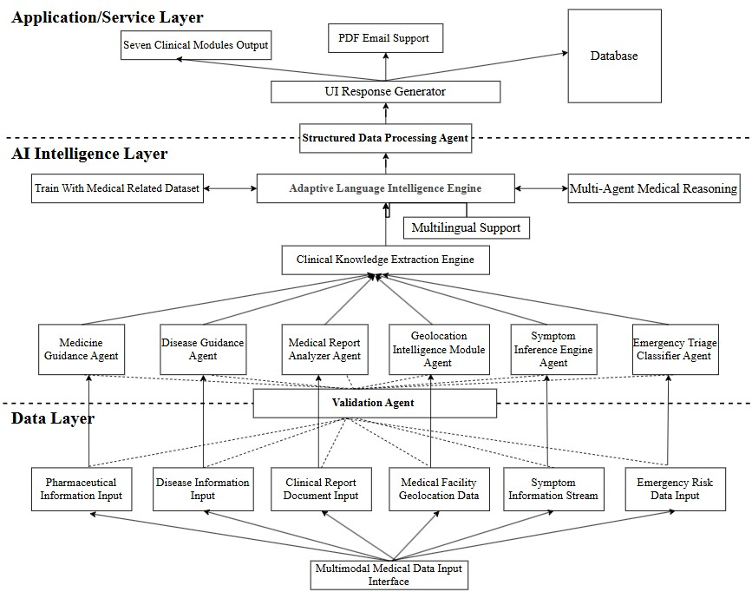
DESIGN – FUNCTIONAL MODULE ARCHITECTURE
HealthAssist AI | Bapatla Engineering College | 2025-26

Slide 11
IMPLEMENTATION
Technology Stack & Tools
🤖
Mistral Large 3
🗄️
Supabase PostgreSQL
Core AI engine: 675B params, MoE architecture, multilingual support & 256K context window
Cloud database: SHA-256 encrypted password storage, authentication & access control
📄
PyPDF2
🔍
EasyOCR
Medical report PDF text extraction pipeline for lab report analysis module
Optical character recognition for extracting text from scanned prescriptions & medical images
📍
Geoapify API
🔐
SHA-256 Auth
Real-time geolocation API for locating hospitals within 30 km radius with coordinates
Cryptographic hash function securing all user health records and session management
Frontend: HTML5 · CSS3 · JavaScript (ES6) · Jinja2 | Backend: Python 3.9 · Flask · Flask-CORS · Werkzeug
HealthAssist AI | Bapatla Engineering College | 2025-26

Slide 12
IMPLEMENTATION – PROCESSING PIPELINE
1
2
3
4
5
6
USER INPUT
AUTHENTICATION
INPUT ROUTING
AI PROCESSING
DATA STORAGE
RESPONSE
Query / Image / PDF / Symptoms via UI
Supabase Auth + SHA-256 session validation
Chat Flow Controller routes to correct module
Mistral Large 3 generates clinical response
Result encrypted & saved in Supabase PostgreSQL
Structured output returned to user with history
🔐 SECURITY: All conversation data encrypted · User-deletable records · Access restricted to authenticated users · Supabase RLS enforced
PARALLEL: OCR Engine (EasyOCR) • PDF Engine (PyPDF2) • Geoapify Hospital API • Google Maps Integration
HealthAssist AI | Bapatla Engineering College | 2025-26

Slide 13
RESULTS & DISCUSSION
Evaluation Metrics Overview
93.64%
81.54%
86.12%
92.89%
Semantic Similarity
METEOR Score
ROUGE-L Score
Anti-Hallucination
Clinical meaning perfectly preserved across all modules — highest score in evaluation.
Strong recall & precision with synonym awareness; slightly lower in complex triage tasks.
Structural coherence & logical response quality across all generated clinical responses.
Only 7.11% incorrect/unsupported statements — prioritizing patient safety and clinical trust.
89.55%
OVERALL SYSTEM ACCURACY — Clinically validated across all 7 modules
HealthAssist AI | Bapatla Engineering College | 2025-26

Slide 14
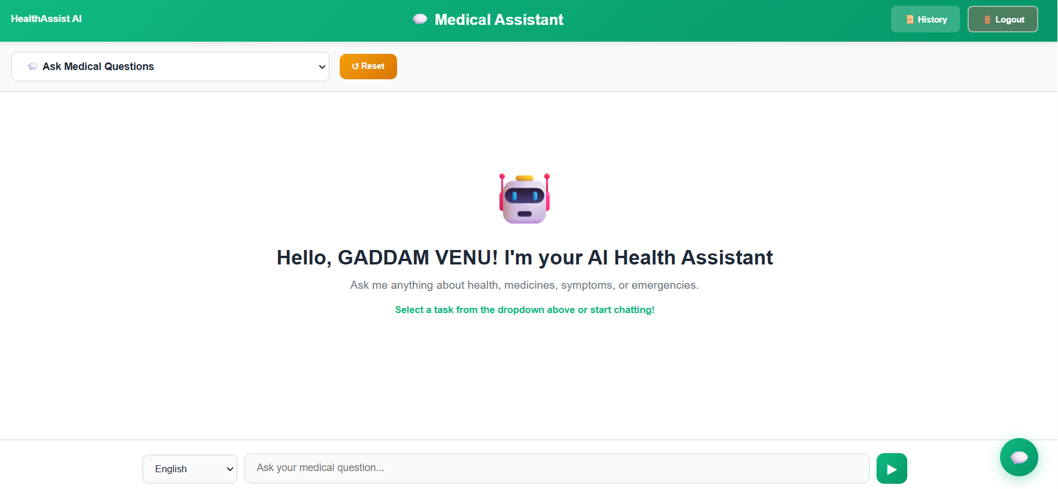
RESULTS – Output1
HealthAssist AI | Bapatla Engineering College | 2025-26

Slide 15
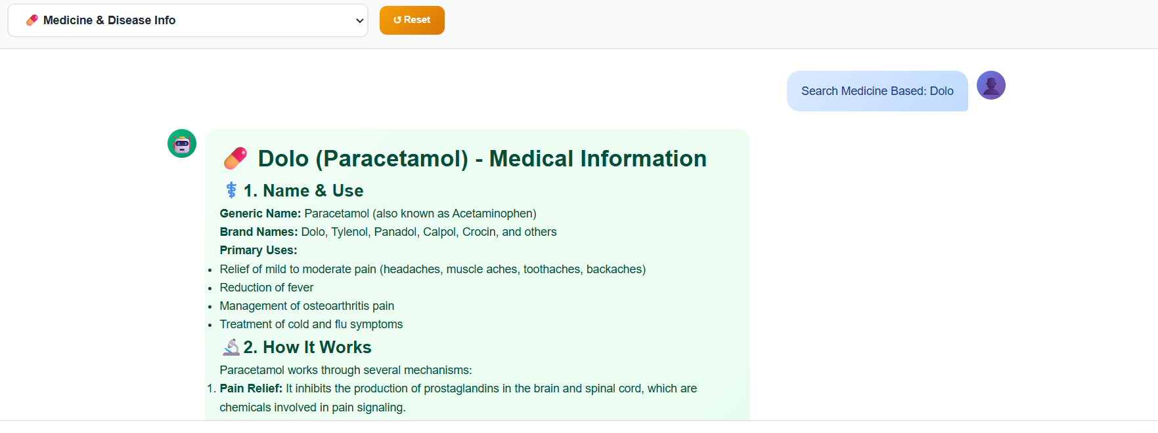
RESULTS – Output2
HealthAssist AI | Bapatla Engineering College | 2025-26

Slide 16
CONCLUSION
Summary & Future Scope
"HealthAssist AI bridges the gap where healthcare infrastructure ends — bringing AI-powered clinical intelligence to those who need it most."
WHAT WE ACHIEVED
FUTURE SCOPE
✓ Seven integrated clinical modules in one platform
✓ 89.55% overall accuracy with only 7.11% hallucination rate
✓ Multilingual AI support via Mistral Large 3 (675B params)
✓ Secure SHA-256 health record management via Supabase
✓ Real-time hospital locator within 30 km via Geoapify API
→ Integration with wearable IoT health devices
→ Real-time EHR (Electronic Health Record) sync
→ Voice-based clinical query support
→ Mobile application with offline AI capability
→ Clinical trial & drug interaction database
HealthAssist AI | Bapatla Engineering College | 2025-26

Slide 17
?
Q&A
Questions & Discussion
Team Members:
Gaddam Venu · Jeevan Devandla · G.S.L Sarojini
D. Srisaiteja · Mudraboina Durgarao
Guide: P.V.N. Srinivas, Asst. Prof., CSE (AIML)
Bapatla Engineering College, Bapatla – 522101
Review Date: 02/04/2026 | NTRB-41 | CM1 to CM5 | Project Work (20CM801/PW01)

Slide 18
Thank
You!
12+
89.55%
86.12%
7.11%
Languages
Accuracy
ROUGE-L
Hallucination
HealthAssist AI
Bapatla Engineering College • CSE (AI & ML)
Hybrid Healthcare Intelligence System
Published: Journal of Dalian University of Technology
Vol. 33, Issue 2, 2026
Empowering Rural Healthcare with Artificial Intelligence
HealthAssist AI | Bapatla Engineering College | 2025-26 | Published: Journal of Dalian University of Technology

